Slide 1
Group 5: Library Software

Slide 2




Joshua Charlesworth
Ricky Ip
Arsen Dzhuraev
Jordan Walker

Slide 3
Priority Requirements
Manage Library Accounts
Should be able to create and delete Library ID’s from the system.
Should be able to put Library ID’s on hold or unfreeze them.
Should be able to check account standing/status when requested.
Every time an account is flagged late for returns, a strike it placed on the account record. Three strikes results in permanent account suspension.
Item Rental Handling
Cardholder should be able to rent out items for a period of 2 weeks before being hit with a late fee and rental hold.
Cardholder should be able be able to pay a late fee to release their account from a rental hold.
Cardholder should be able to waitlist an item to their ID.
Librarians may also rent out items just like a Cardholder because they are an extension of their privileges.
Library Inventory Management
Anybody should be able to search the entire library database for items without a Library ID
Librarians/Staff should be able to transfer items between locations.
Librarians/Staff should be able to add or remove items from a locations inventory.
Librarians/Staff should be able to modify the waitlist for an item
Location Management
Librarian should be able to add or remove library locations from database.
Librarian should have access to each locations attributes such as name, address, etc.
External Interface or GUI
System should use a simple to navigate Java based GUI allowing the Librarian easy access to all the management features of the Library Management System.
Notes:
Checking in/out - Basic Library functions
Transferring items - Since this is a network of libraries, efficient transfer of items between libraries is essential
Member vs Staff Support - Staff will extend the role of a member by being able to administrate accounts and books
Simple Gui - Allowing user to digitally explore the full library after logging in.

Slide 4
Class Candidates
Member
-string UserID
-string password
-int standing
-item[] checkedOutItems
-item[] reservedItems
+Member()
+getters
+setters
Librarian(extends member)
-staffID
+void checkOutItems()
+void checkinItems()
+void acctHandling()
Item
-string itemID
-string title
-string year
-Member owner
-Location location
+getters()
+setters()
+delete
Book(extends Item)
-string title
-string author
-string genre
+Book(title, author, genre, Location)
+getters
+setters
+void editBook()
Location
-item[] inventory
-Member[] staff
-string locationID
+Location(locationFile)
+void transferItem(location)
+void sortBy(Specification spec)
Transaction
-string staffID
-string subjectID
-Date
+Transaction()
+getters()
+setters()

Slide 5
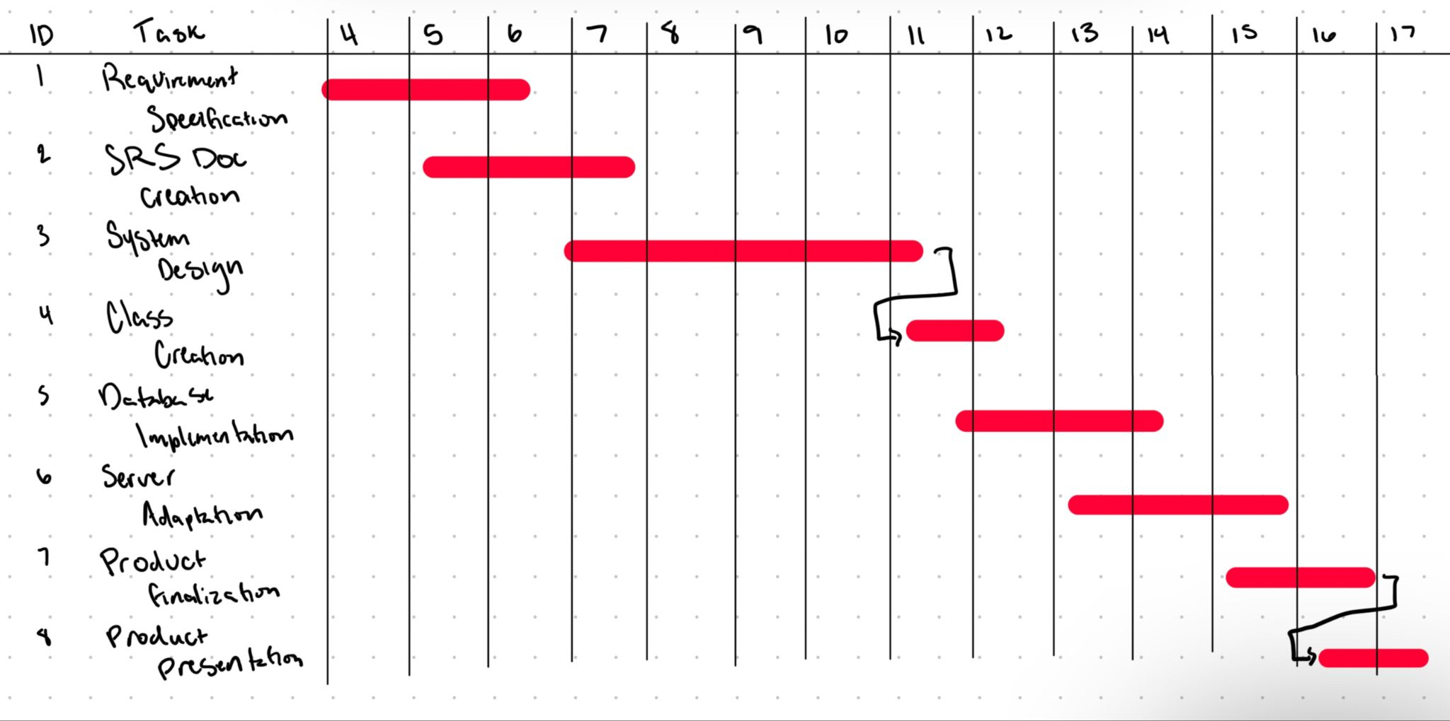
Estimated Timeline of Project Progression Gantt Chart (in weeks)

Slide 6
Thank you!
Questions or Suggestions?

